Slide 1
Introduction to using APIs in Alma and the Ex Libris Developer Network
Yoel Kortick
Senior Librarian
June 2025

Slide 2
Agenda
Introduction
Documentation
Creating and Managing API Keys
The API Console
API Usage Reports
Blog Posts

Slide 3
Introduction

Slide 4
Introduction
In addition to this presentation, for information about using APIs, see A series of "How To APIs" blogs
This series of blog posts is intended to accompany this presentation.

Slide 5
Introduction
Ex Libris is committed to an open platform, which includes support for integrations via open standards and REST APIs.
This support enables institutions to integrate Ex Libris solutions with local systems, create innovative services, increase the value of the library, and help meet the institution’s goals and objectives.

Slide 6
Introduction
The Developer Network is the one-stop shop for system librarians, developers, and IT engineers.
Here you can view documentation related to all Ex Libris products, read about successful integrations in the blog, ask a question on the forum, and manage your own usage of Ex Libris APIs.

Slide 7
Introduction
The Developer Network is open to everyone.
Each user can view all of the content without an account, and even try out Alma and Primo APIs in the API Console.
  To create a blog post or ask a question on the forum, you can create an account for yourself.
  If you’re already an Ex Libris customer, your institution was provided credentials to the Developer Network which allow you to create API keys which give you access to your institution’s environments.

Slide 8
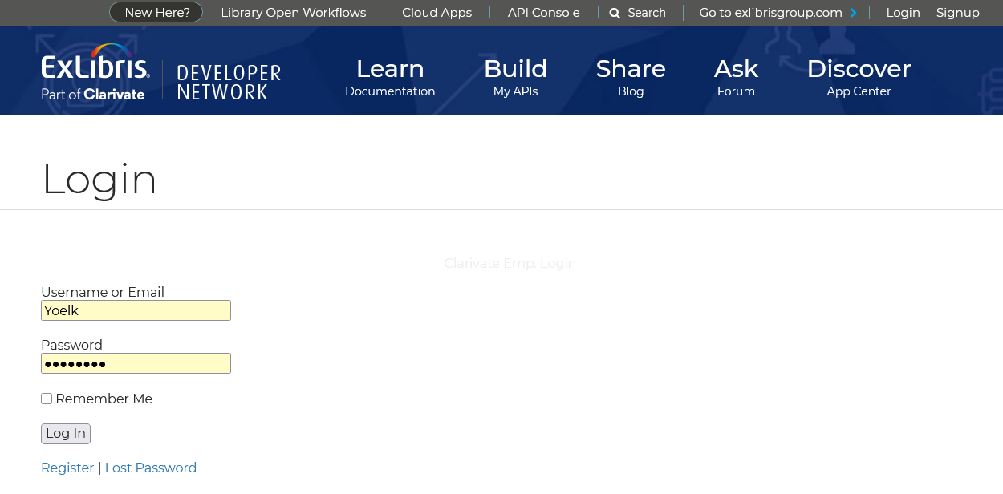
Introduction
Here we log in with credentials provided to the institution.

Slide 9
Documentation

Slide 10
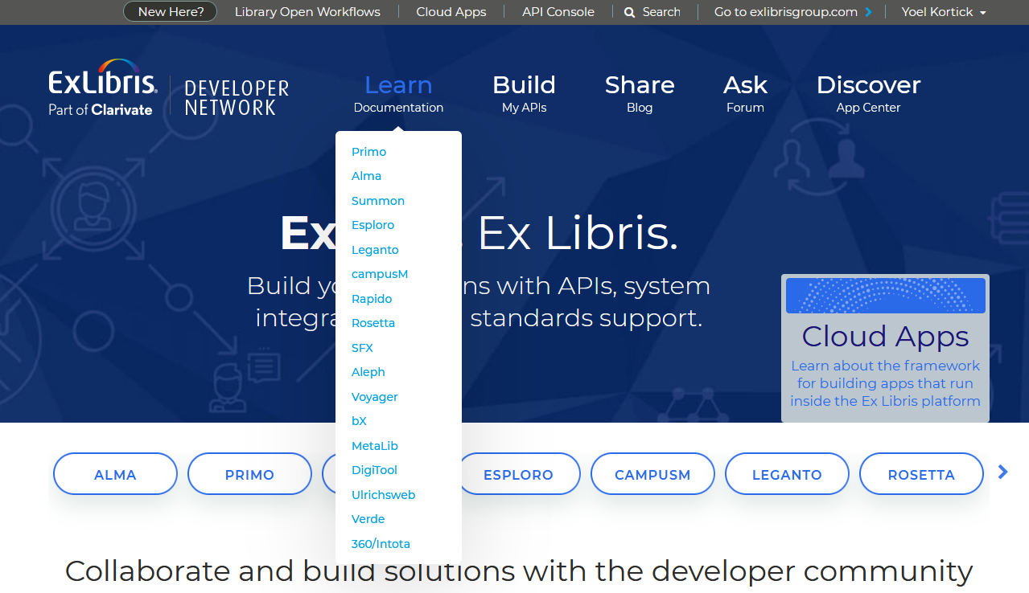
Documentation
Choose desired area of documentation

Slide 11
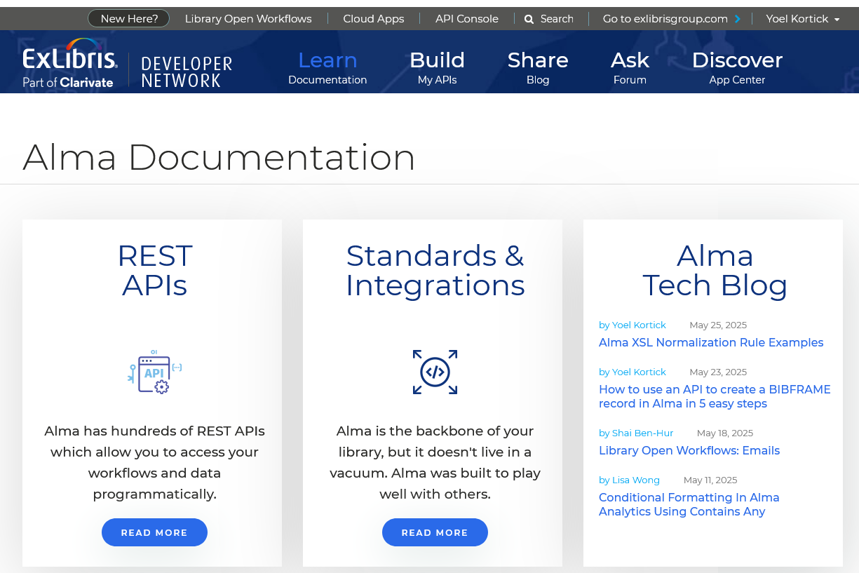
Documentation
Choose desired sub-area of documentation
We will click “Read More” for “REST APIs”

Slide 12
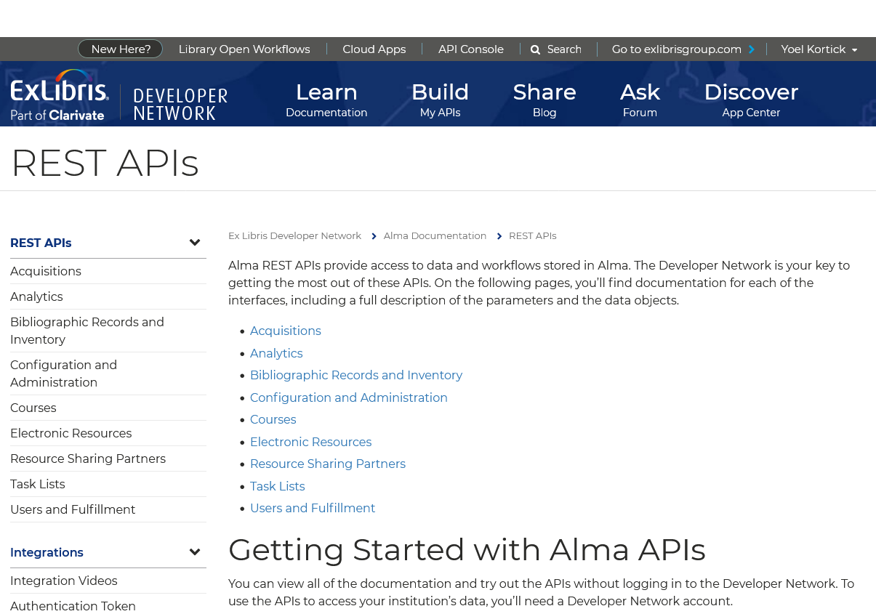
Documentation
Continue navigating
We will click “Acquisitions”

Slide 13
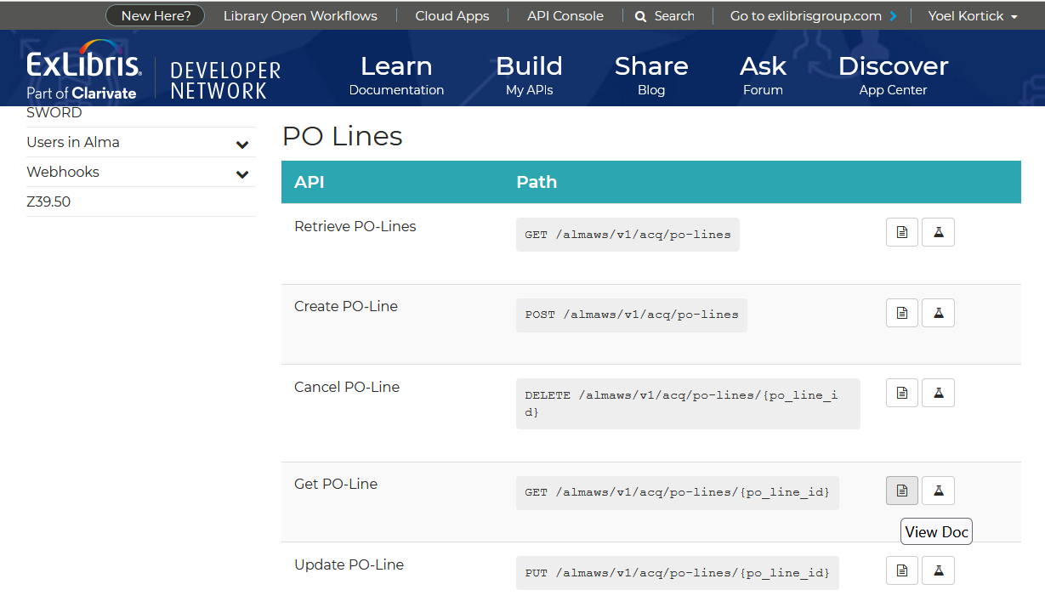
Documentation
Navigate to further in-depth documentation
We will click “View Doc” for “Get PO-Line

Slide 14
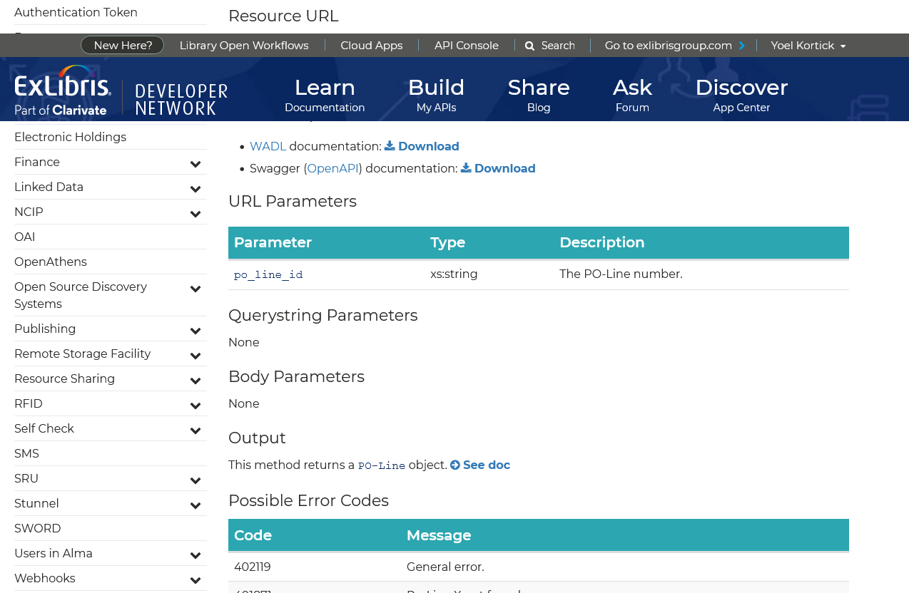
Documentation
View the more in-depth documentation

Slide 15
Documentation
The documentation also links to details of Standards & Integrations
We will click “Read More” for “Standards & Integrations”

Slide 16
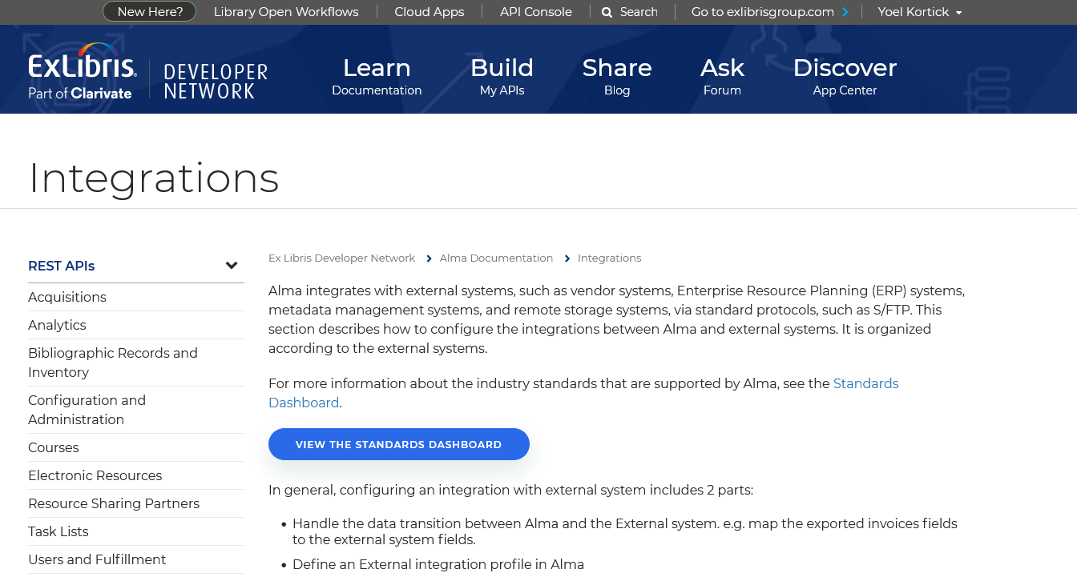
Documentation
This includes a Standards Dashboard
We will click “View the Standards Dashboard

Slide 17
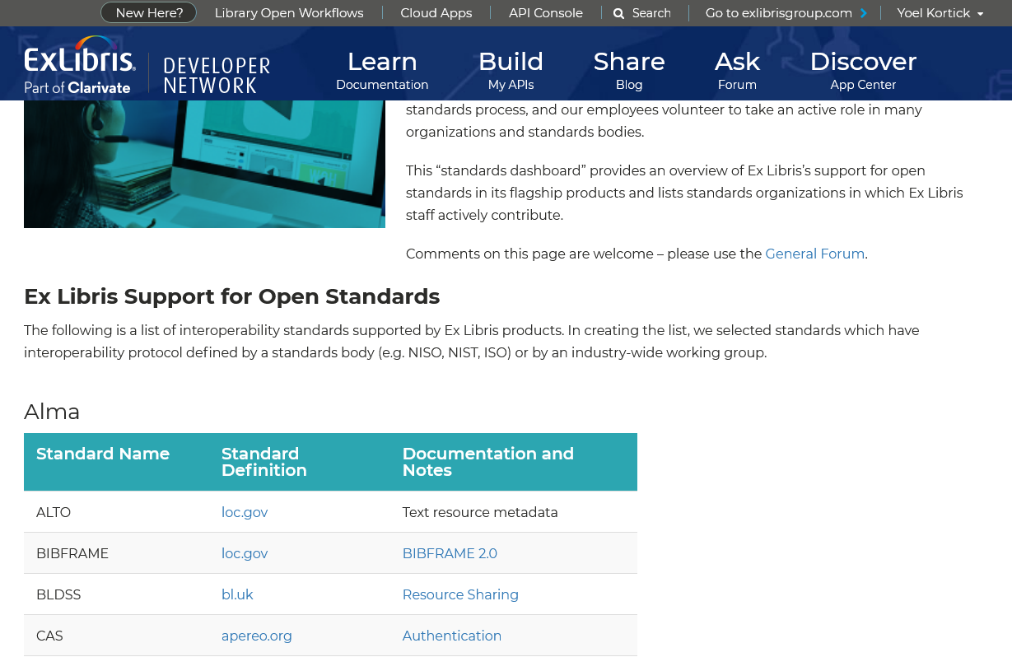
Documentation
Here is the Standards Dashboard

Slide 18
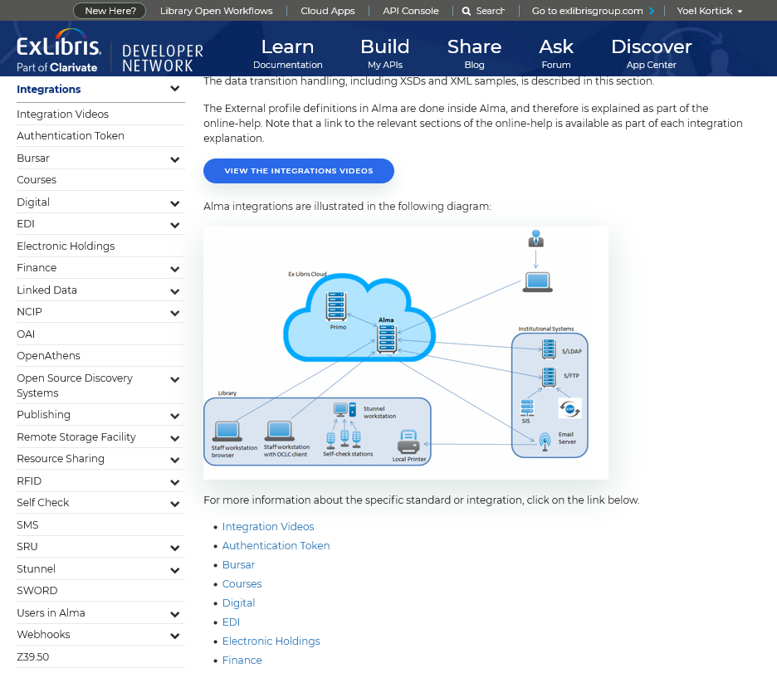
Documentation
The “Standards & Integrations” page also contains links to details of specific integrations

Slide 19
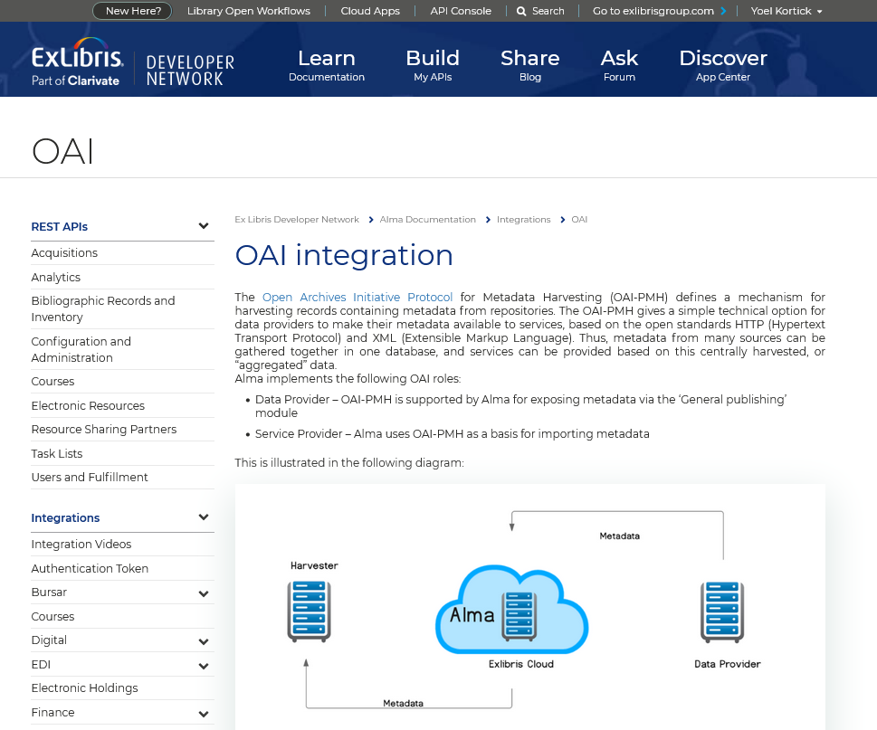
Documentation
Here for example is the link to the OAI Integration

Slide 20
Documentation
The documentation also includes blogs written by staff of both Ex Libris as well as live institutions (more later on creating blog posts)

Slide 21
Creating and Managing API Keys

Slide 22
Creating and Managing API Keys
In order to run an API an appropriate API key must be used
The API key can
  Point to the sandbox or production environment
  Be designed for read only or for read/write

Slide 23
Creating and Managing API Keys
Each API key relates to one or more general areas, such as Acquisitions, Analytics, Configuration, Courses, etc.
In this way when API keys are given to third party vendors for integration purposes, the institution can control
  Which data can be accessed
  If the data can be only retrieved (GET) or also deleted, created and updated (DELETE, PUT and POST).

Slide 24
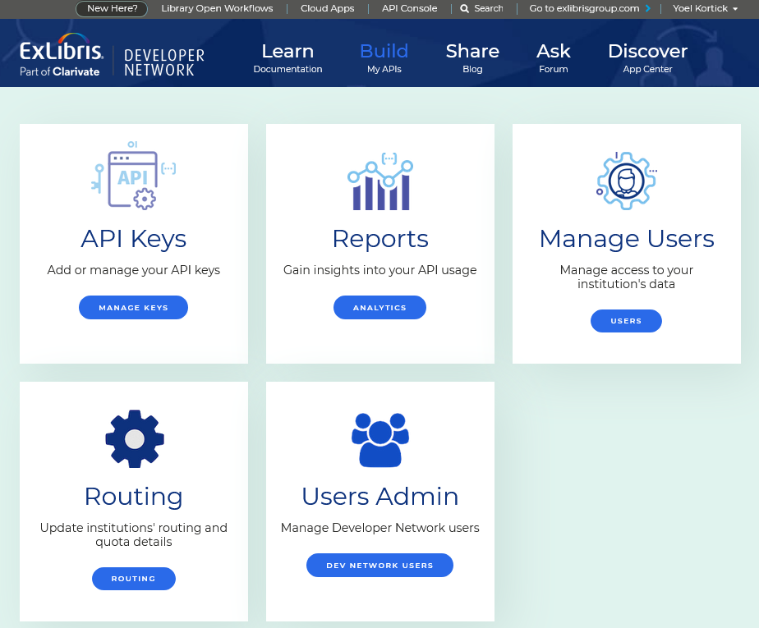
Creating and Managing API Keys
API Keys are managed and via the link at “Build My APIs > API Keys”

Slide 25
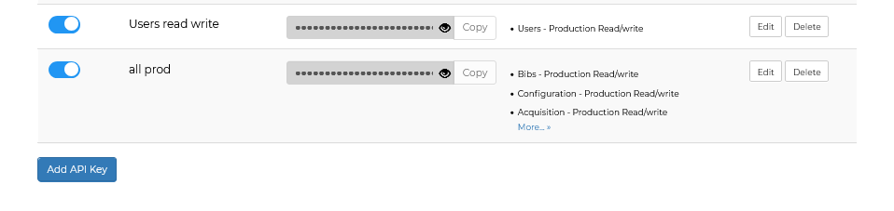
Creating and Managing API Keys
Now we will create an API key for acquisitions activities for read and write in the production environment. Scroll to the bottom of the list of existing API Keys (if there are already API Keys) and click “Add API key”

Slide 26
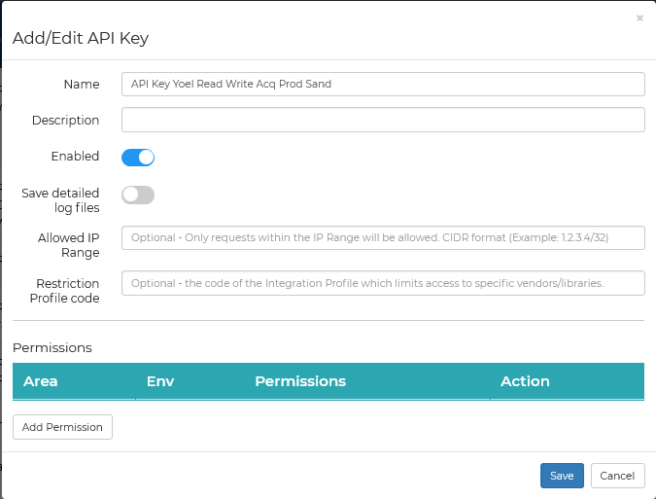
Creating and Managing API Keys
We have given the API key a name and now we will add permissions

Slide 27
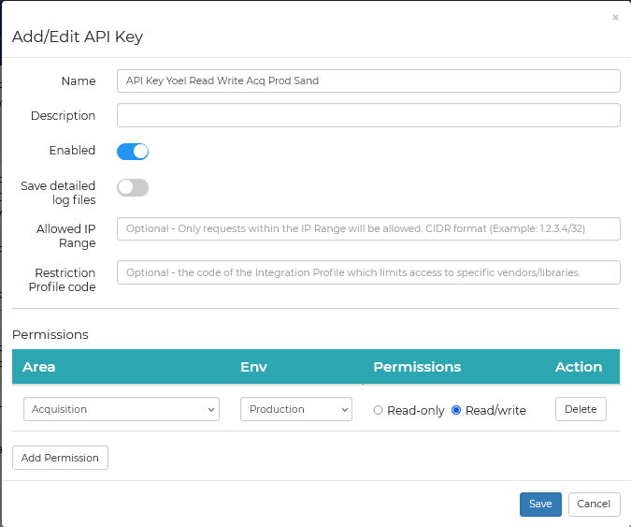
Creating and Managing API Keys
We added permission for acquisitions for production with Read/Write
Additional permissions for additional areas can be added for the same API key.

Slide 28
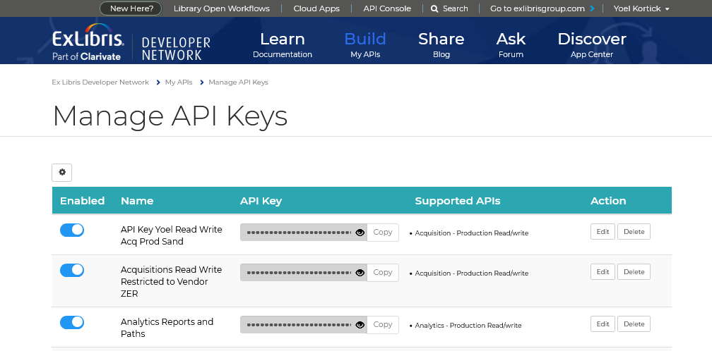
Creating and Managing API Keys
Now the new API Key appears in the list
In a moment we will use this new API key in the API console

Slide 29
Creating and Managing API Keys
As we can see it is not possible to see what the API key is. This is for security purposes.

Slide 30
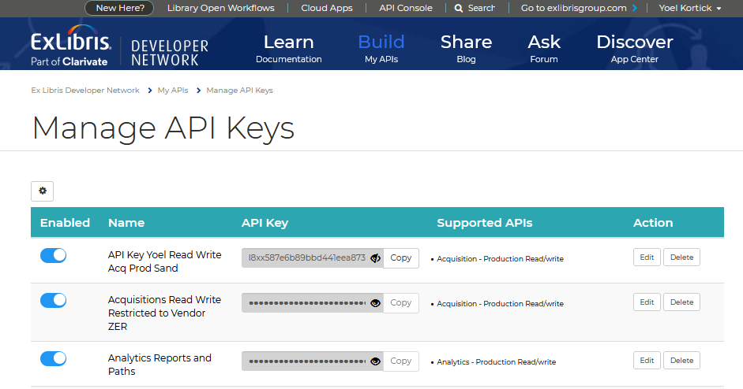
Creating and Managing API Keys
It is possible however to click the eye icon next to the API key and then view it and copy it.

Slide 31
The API Console

Slide 32
The API Console
The API Console can be used to run APIs and includes sample input (payload) data as well as built in links to the interactive documentation.
In this way it is not necessary to switch back and forth between the API documentation and a REST client because all is together in one convenient location.

Slide 33
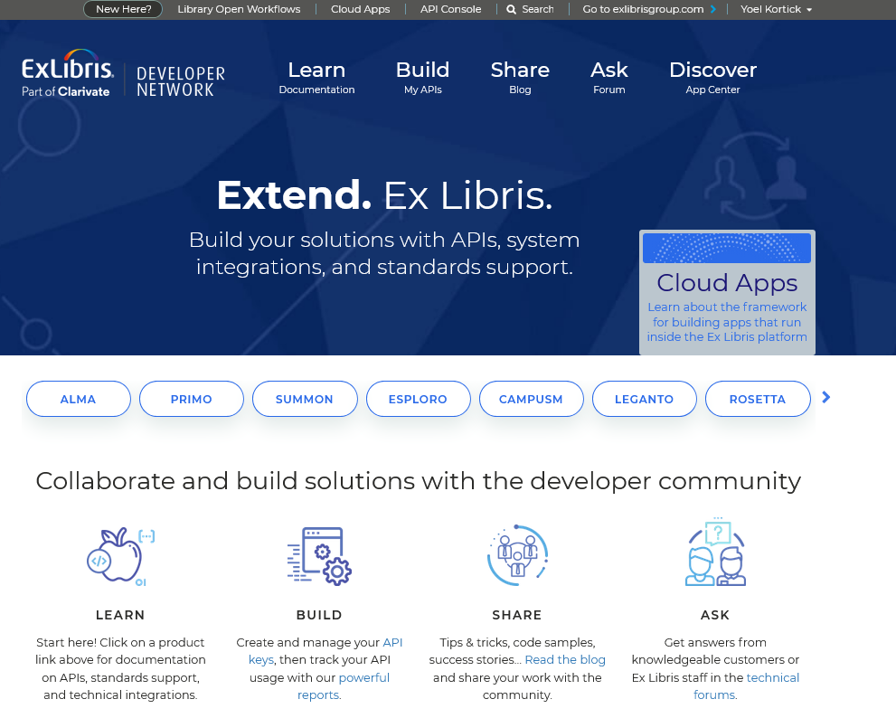
The API Console
Access the API Console

Slide 34
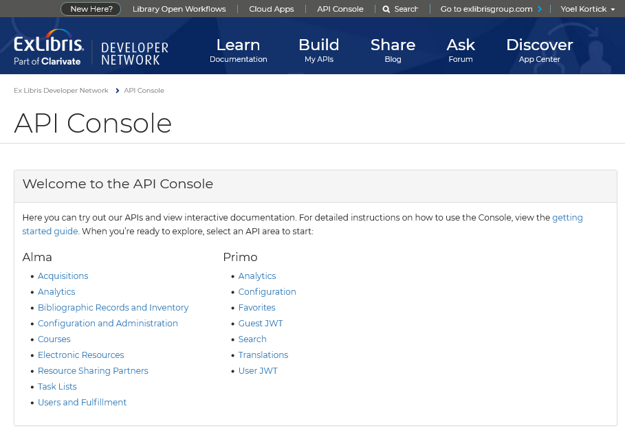
The API Console
Choose the API area in which you want to work
We will choose Acquisitions

Slide 35
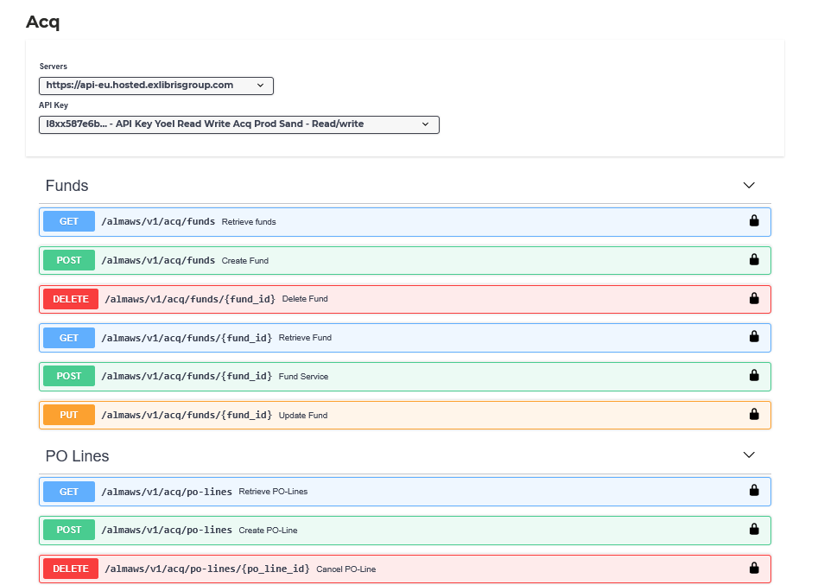
The API Console
Select API Key and specific API
The API key we made a moment ago

Slide 36
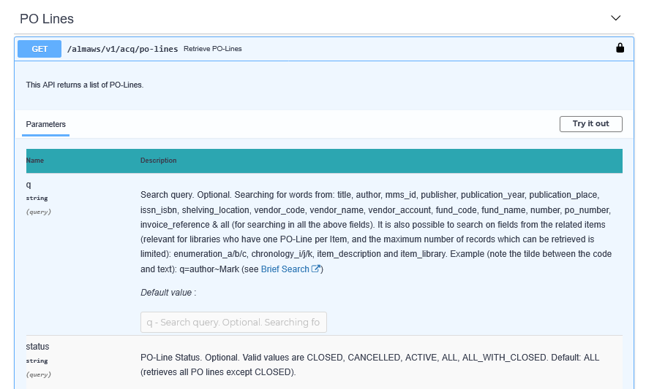
The API Console
View the syntax, read the documentation, and "Try it out"

Slide 37
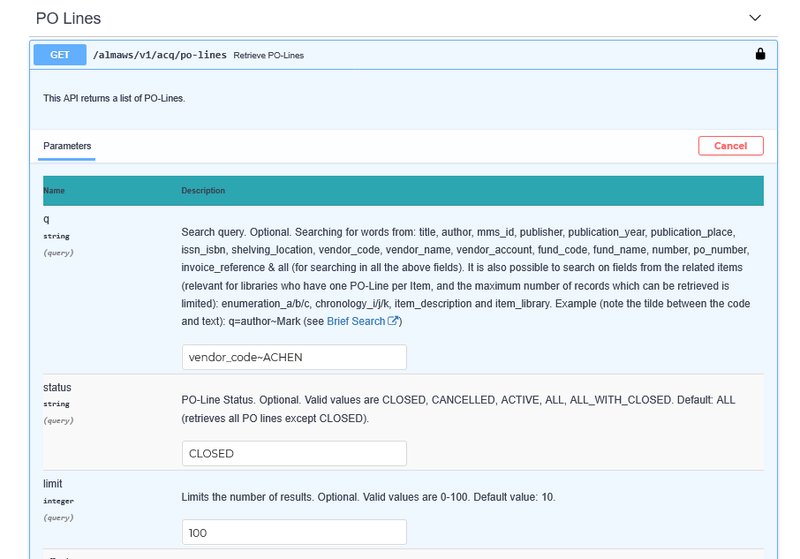
The API Console
Here we "Try it out"
We are retrieving POLs with
Vendor code ACHEN
In status CLOSED
100 POLs at a time

Slide 38
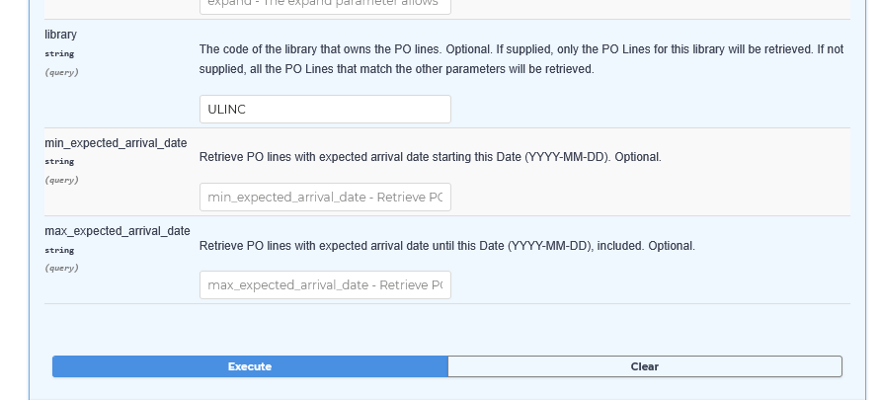
The API Console
Scroll down and fill in additional optional parameters
Execute
We are retrieving POLs with
Library code ULINC

Slide 39
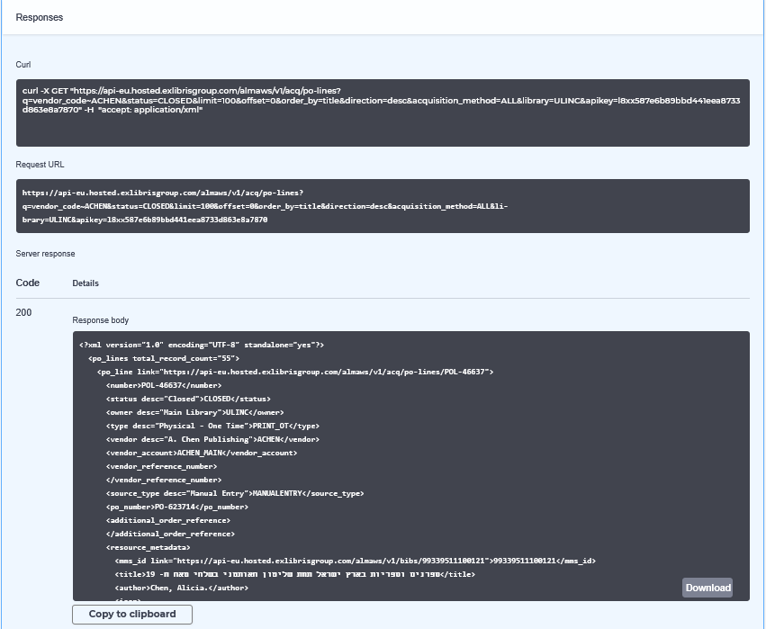
The API Console
View results as well as syntax

Slide 40
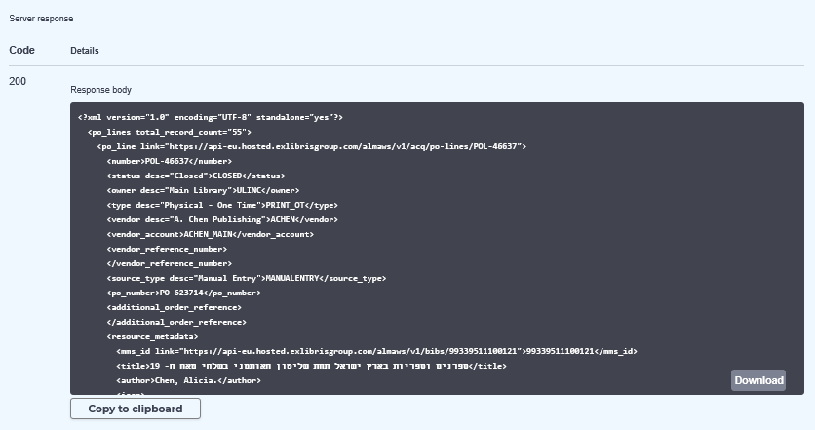
The API Console
The response body can be copied to clipboard or downloaded to a file

Slide 41
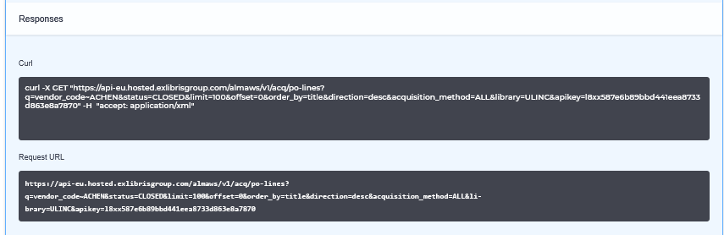
The API Console
The Curl or Request URL can be used as syntax for the application with which the institution is integrating.

Slide 42
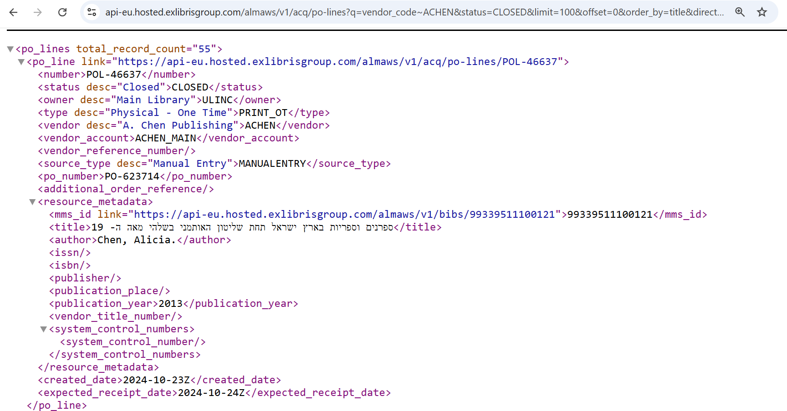
The API Console
Here we have pasted the Request URL into a browser and see that the API brings the results
We are retrieving POLs with
Vendor code ACHEN
In status CLOSED
In library ULINC

Slide 43
The API Console
When creating data in the API console, for example a bibliographic record via POST, the API console both
  Includes a link to documentation describing the input (payload)
  Provides a sample input on the page of the API console to run the API

Slide 44
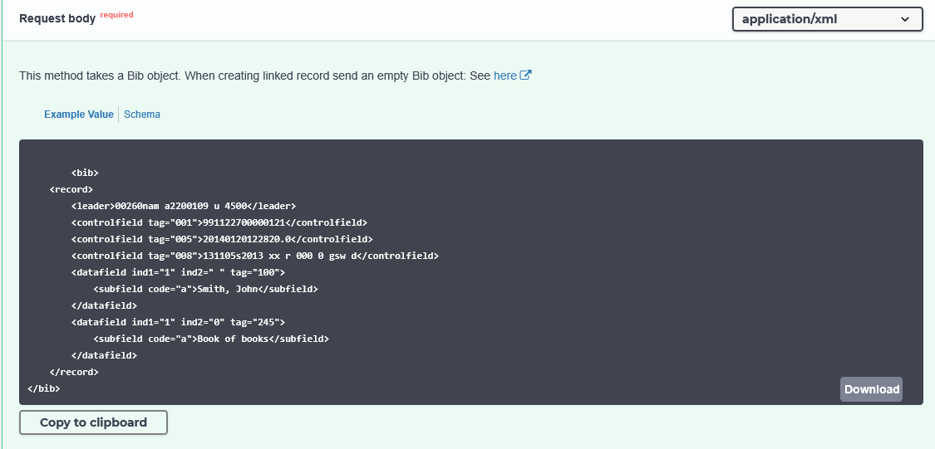
The API Console
Link to documentation explaining input
Sample input

Slide 45
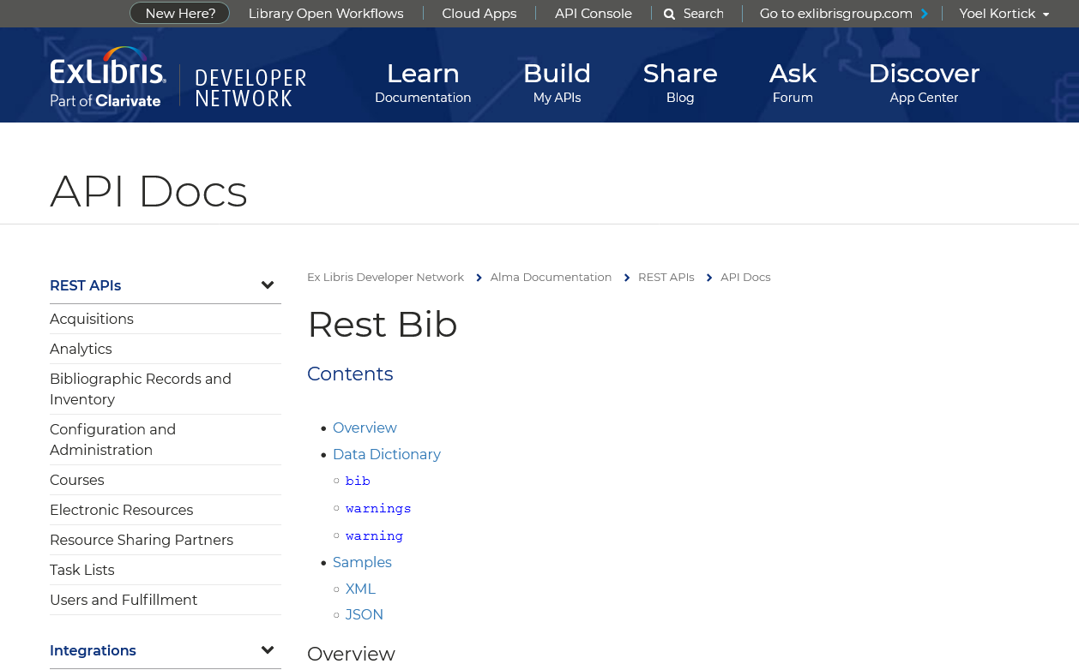
The API Console
For example, in this case the link to documentation arrives here

Slide 46
The API Console
<bib>
<suppress_from_publishing>false</suppress_from_publishing>
<record>
<leader>00260nam a2200109 u 4500</leader>
<controlfield tag="005">20190120122820.0</controlfield>
<controlfield tag="008">131105s2019 xx r 000 0 gsw d</controlfield>
<datafield ind1="1" ind2=" " tag="100">
<subfield code="a">Zafrani, Elia</subfield>
</datafield>
<datafield ind1="1" ind2="0" tag="245">
<subfield code="a">French women entrepreneurs in the information industry</subfield>
</datafield>
<datafield ind1=" " ind2="1" tag="264">
<subfield code="a">Dimona</subfield>
<subfield code="b">Dimona Press</subfield>
<subfield code="c">2019</subfield>
</datafield>
<datafield ind1=" " ind2="0" tag="650">
<subfield code="a">Businesswomen</subfield>
<subfield code="z">France</subfield>
<subfield code="v">Case studies</subfield>
</datafield>
<datafield ind1=" " ind2="0" tag="650">
<subfield code="a">Women-owned business enterprises</subfield>
<subfield code="z">France</subfield>
<subfield code="v">Case studies</subfield>
</datafield>
<datafield ind1=" " ind2="0" tag="650">
<subfield code="a">Entrepreneurship</subfield>
<subfield code="z">France</subfield>
<subfield code="v">Case studies</subfield>
</datafield>
</record>
</bib>
The staff user has decided to run the API to create the bibliographic record and use his own input based on the sample input already in the API console.

Slide 47
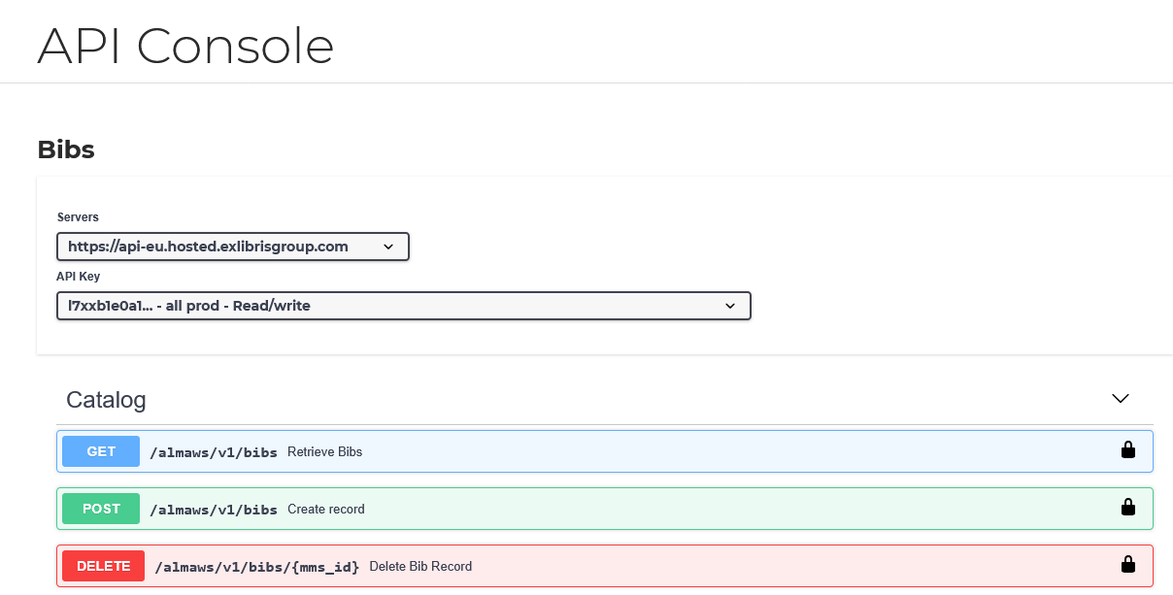
The API Console
The staff user will now run a POST to create a bibliographic record using the API Console and the input (payload) on the previous slide

Slide 48
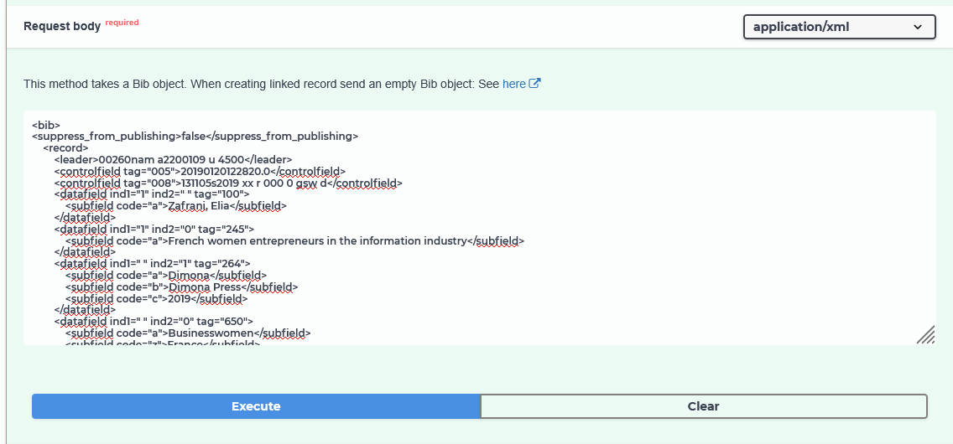
The API Console
The staff user will now run a POST to create a bibliographic record using the API Console

Slide 49
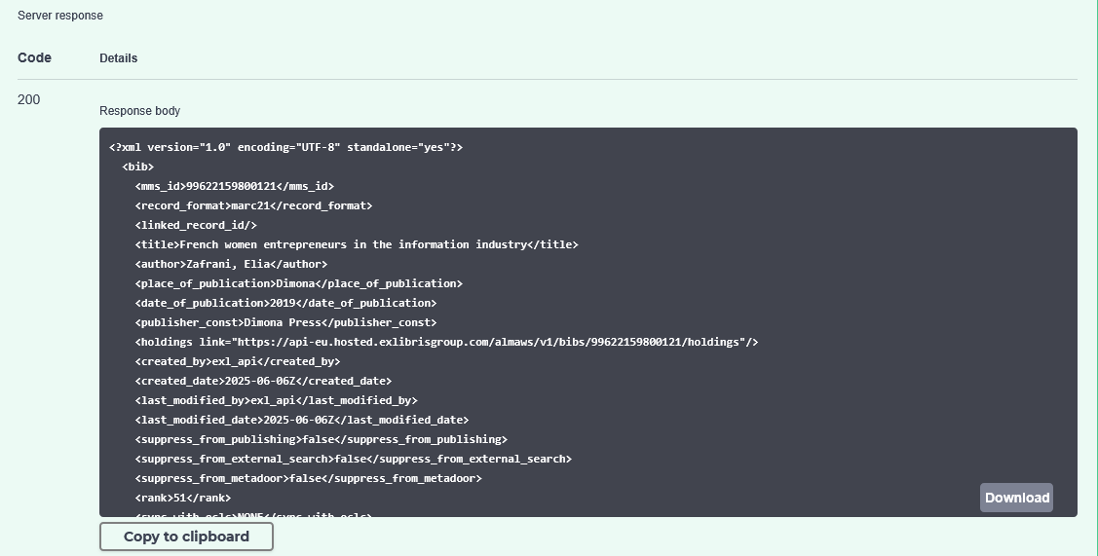
The API Console
We see in the response that the record is created and gets an MMSID

Slide 50
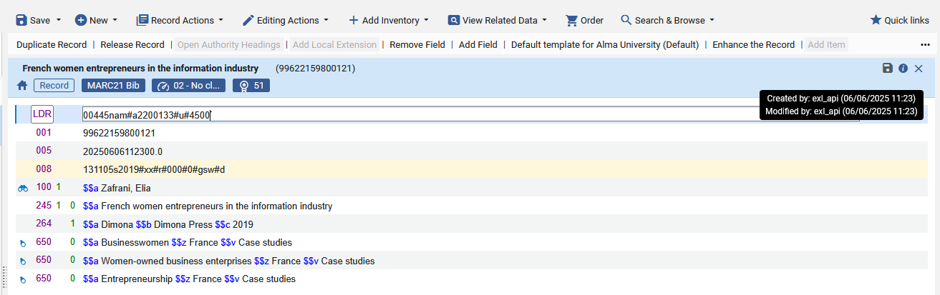
The API Console
In Alma we see that the record was crested via the API

Slide 51
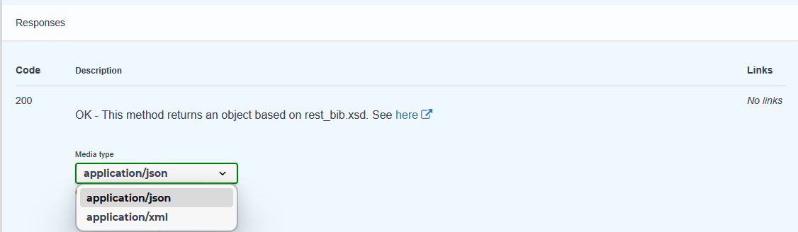
The API Console
While the default is for the API Console to return data in xml, it is also possible to define that the data will be returned in json format

Slide 52
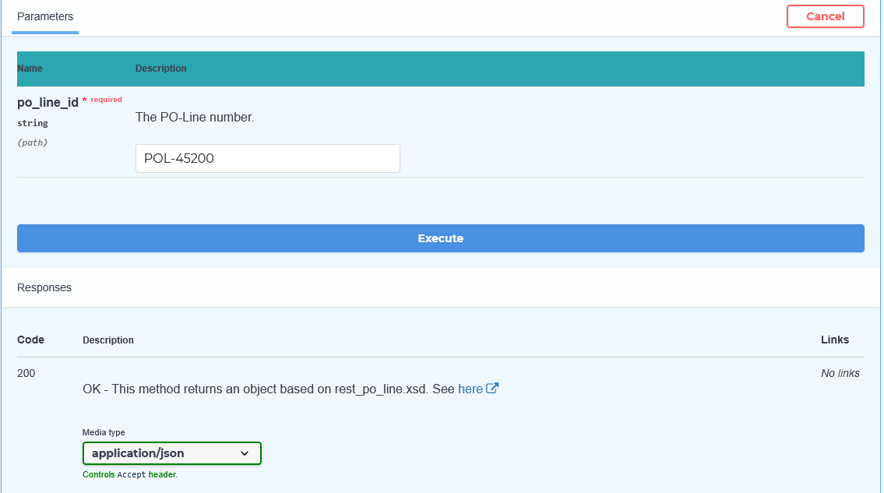
The API Console
For example, here we will do a GET for a POL in format JSON

Slide 53
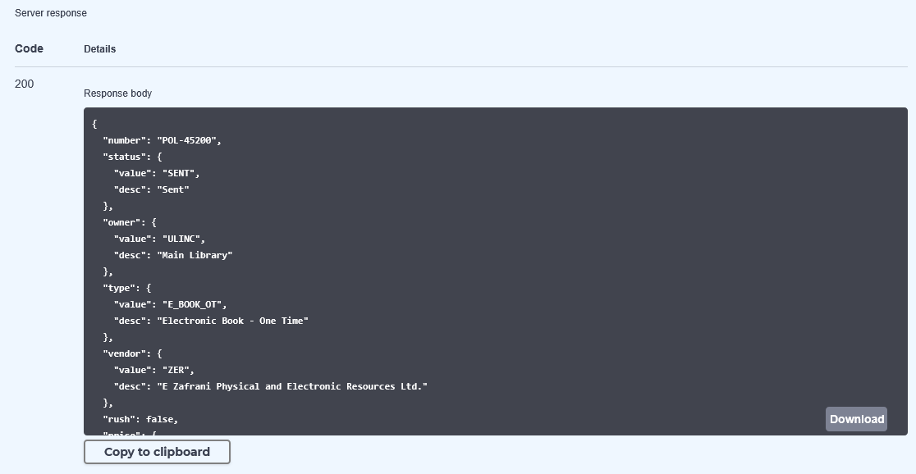
The API Console
The response is in format JSON

Slide 54
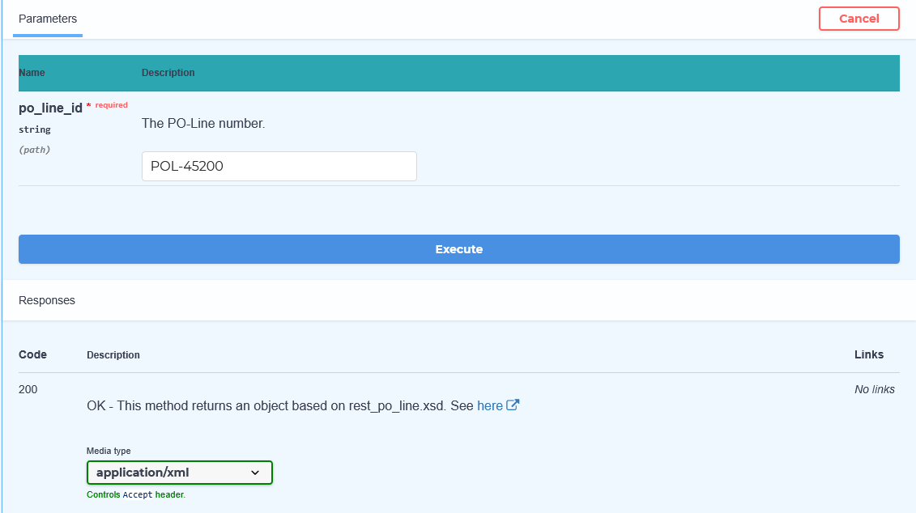
The API Console
Now we will do the same GET for a POL in format XML

Slide 55
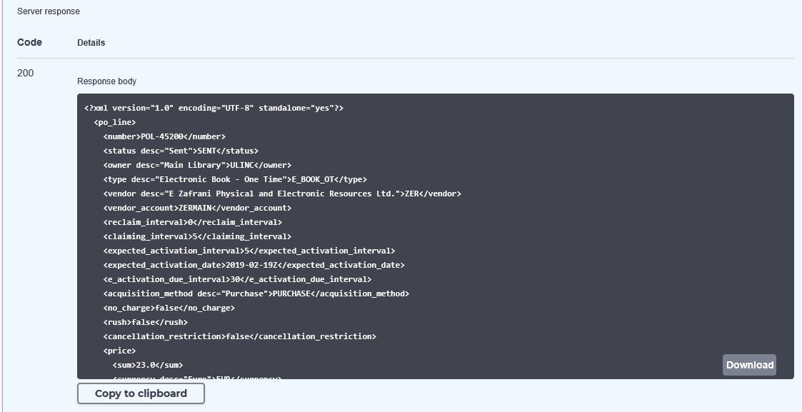
The API Console
The response is in format XML

Slide 56
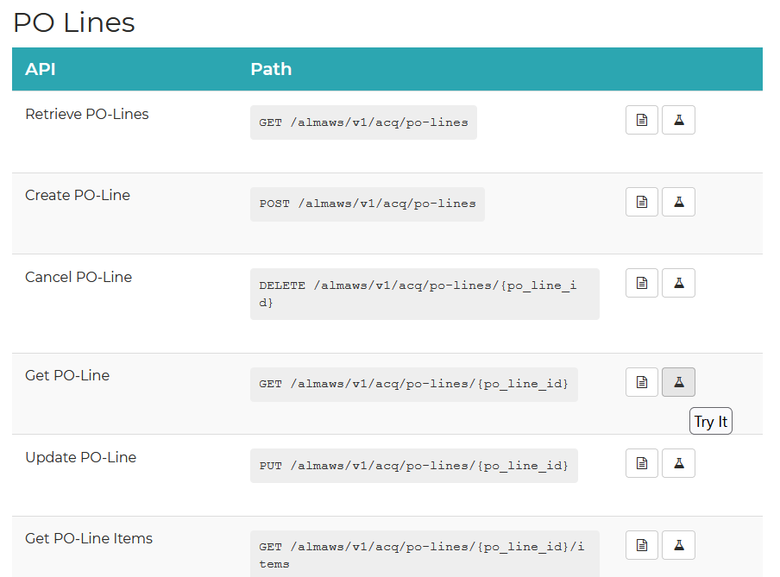
The API Console
Note also that from within the documentation section of the Developer Network it is possible to access the API console via the "Try It" link

Slide 57
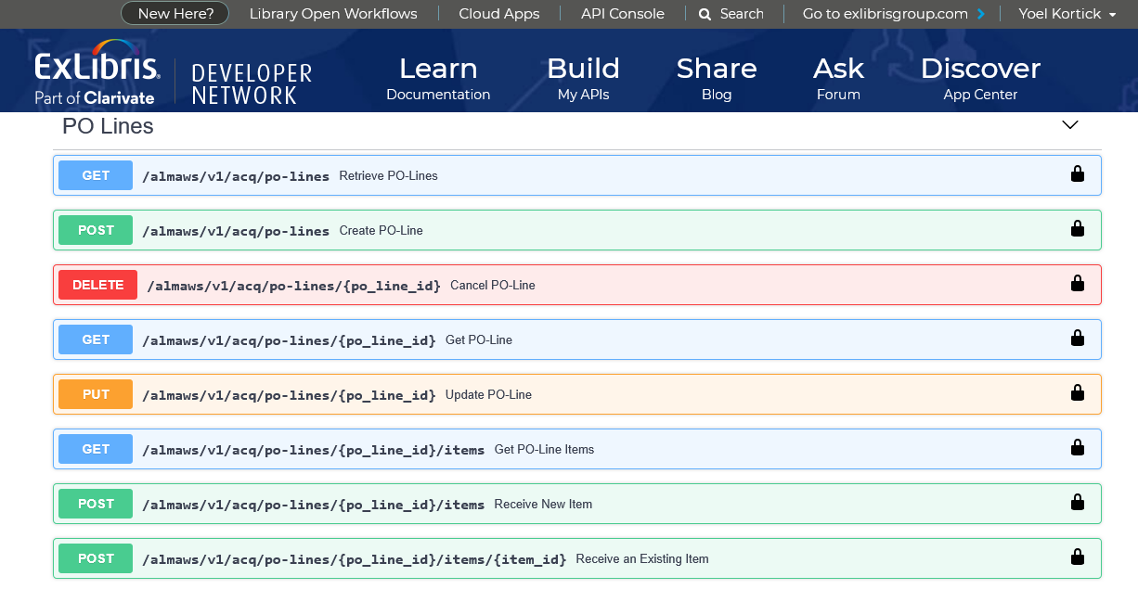
The API Console
After clicking the "Try It" the user will arrive to the API console in the area from which he or she came (in this case Acquisitions)

Slide 58
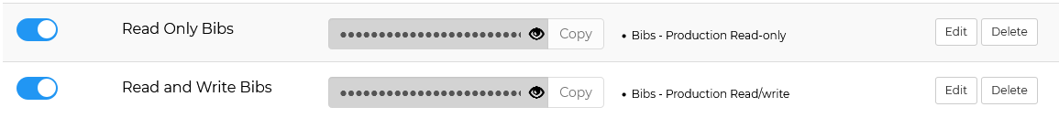
The API Console
Further, note that in the API Console the options for which APIs run depend on the permissions of the API key chosen
For example, here we have two API keys, one which allows for read only and one which allows for full read/write

Slide 59
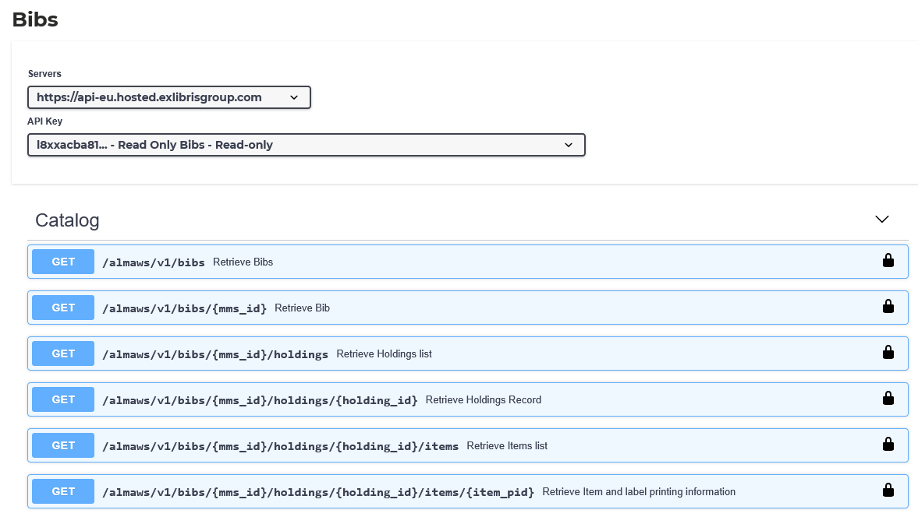
The API Console
The API Key is “Read Only” and there are only APIs of type GET

Slide 60
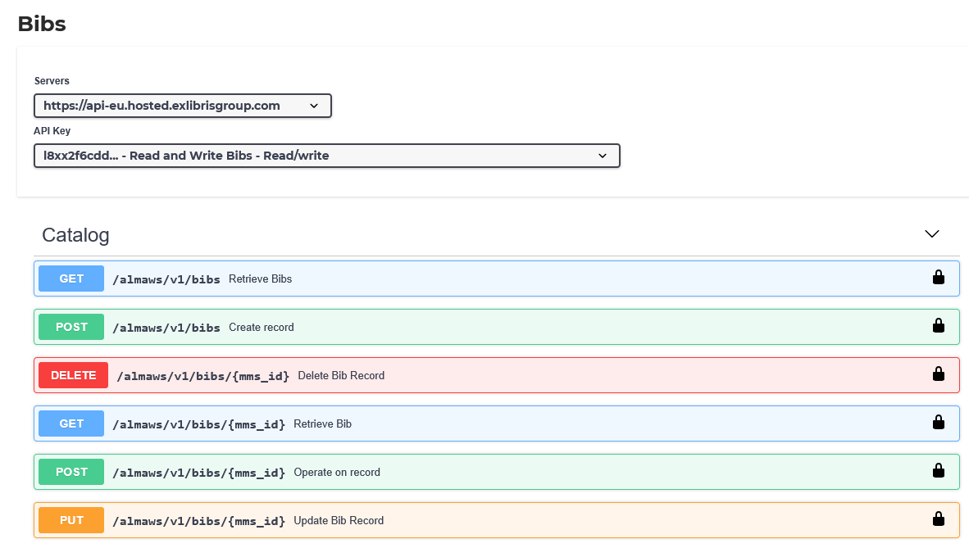
The API Console
The API Key is “Read / Write” and there are APIs of type GET, PUT, POST and DELETE

Slide 61
API Usage Reports

Slide 62
API Usage Reports
Each institution can gain insight into their API usage via built in analytics reports.
These reports may be accessed via "Build my APIs > Reports Analytics"

Slide 63
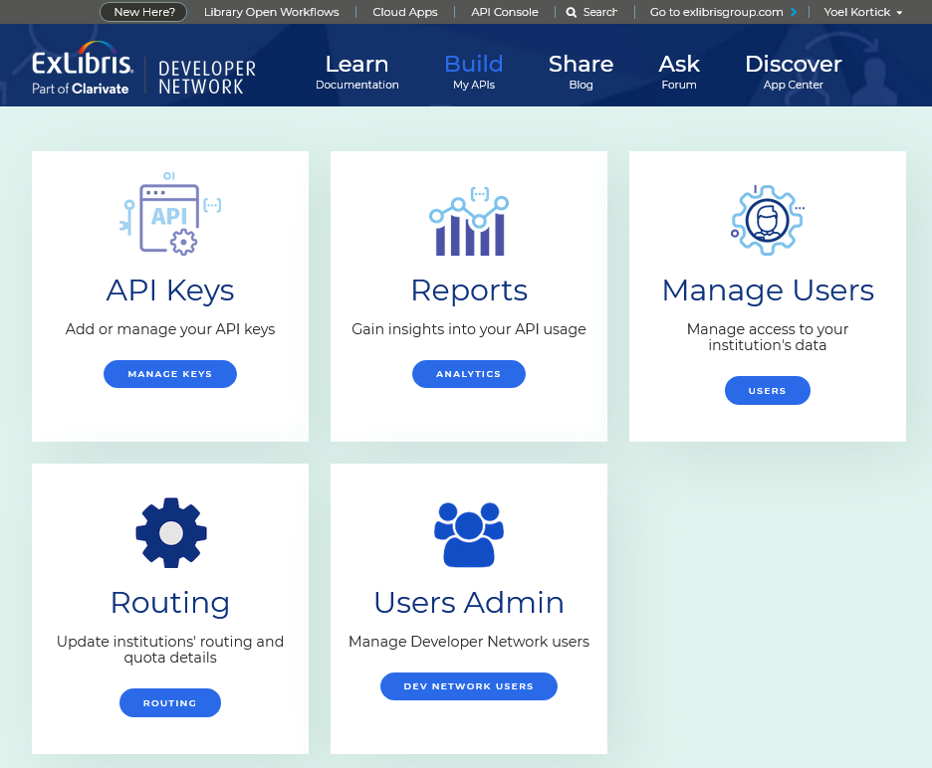
API Usage Reports

Slide 64
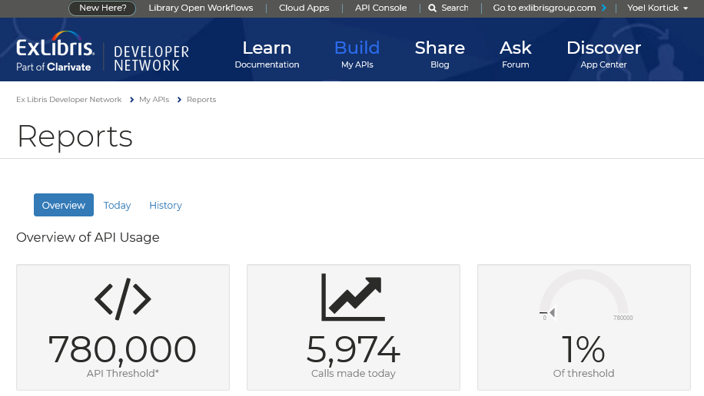
API Usage Reports
The default page shows an overview of APIs run the same day and how much percentage this is of the threshold

Slide 65
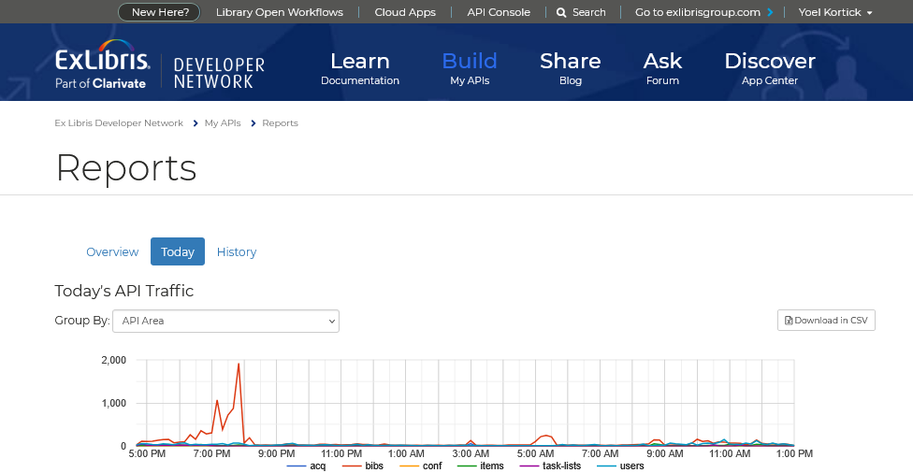
API Usage Reports
It is also possible to see details reports of "today" or "history"

Slide 66
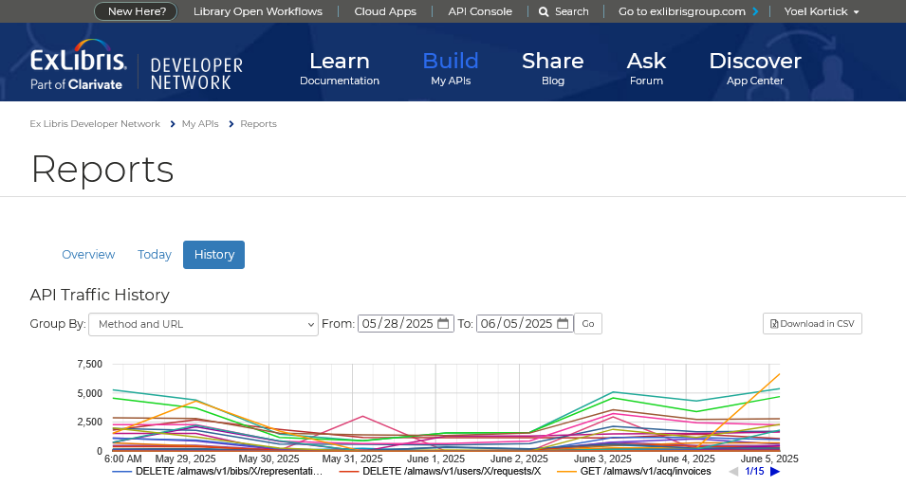
API Usage Reports
The reports can be grouped by:
  API Area
  API Key
  Method and URL
Here we have done by “Method and URL for the last week. The report can be exported.

Slide 67
Blog Posts

Slide 68
Blog Posts
Blogs from both Ex Libris staff members as well as staff members of libraries may be accessed via the "Share Blog" link as well as the "Learn Documentation" link (as previously seen).
The next slide shows two examples: one blog post from a staff member of a library and one blog post from an Ex Libris staff member.

Slide 69
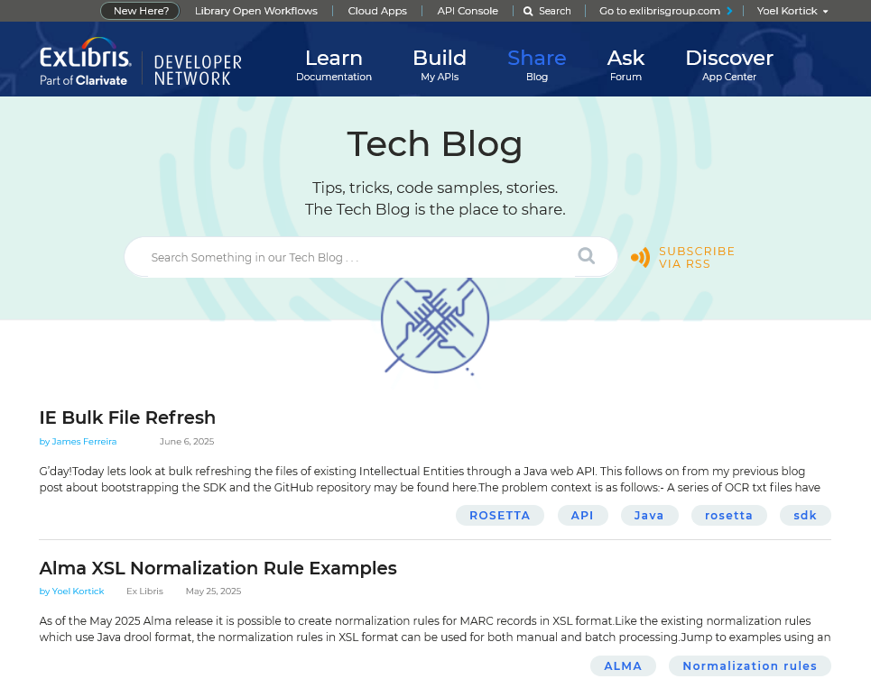
Blog Posts
Blog post from a staff member of a library
Blog post from an Ex Libris staff member

Slide 70
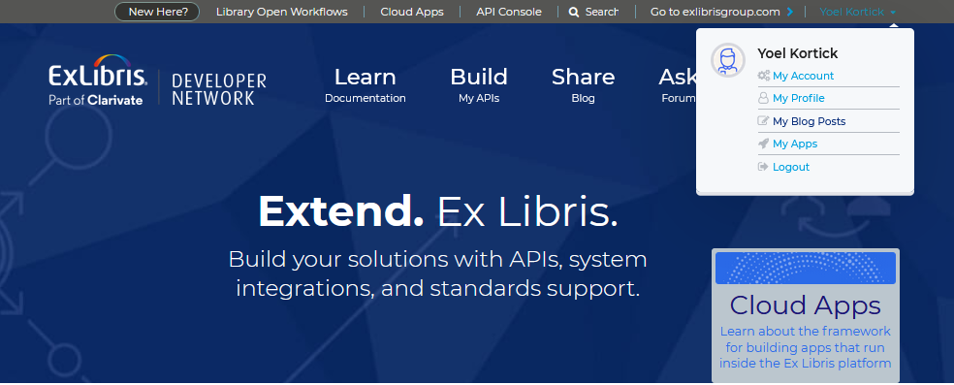
Blog Posts
Blogs may be added (and later edited) by accessing "My Blog Posts" and then "Create a blog post"

Slide 71
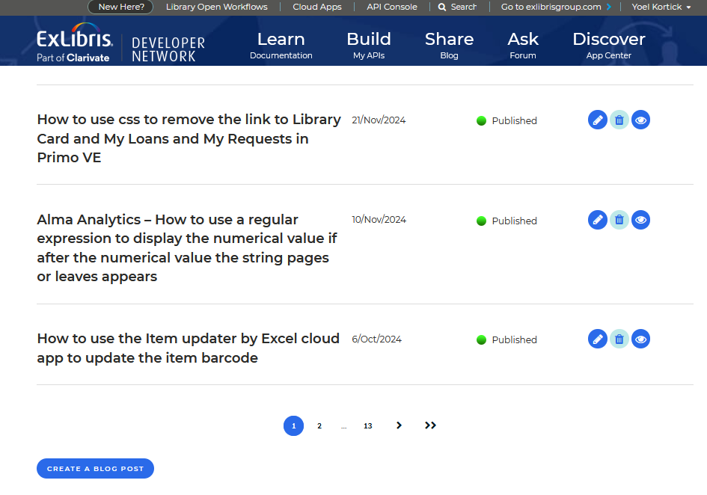
Blog Posts

Slide 72
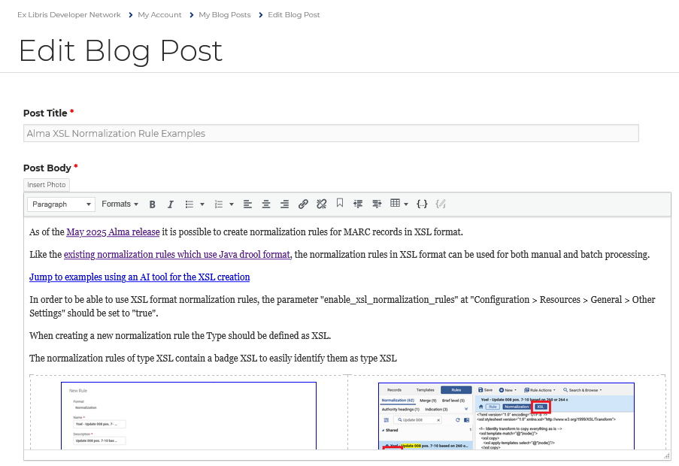
Blog Posts
The page for creating and editing a blog features an easy to use and intuitive interface

